Slide 1
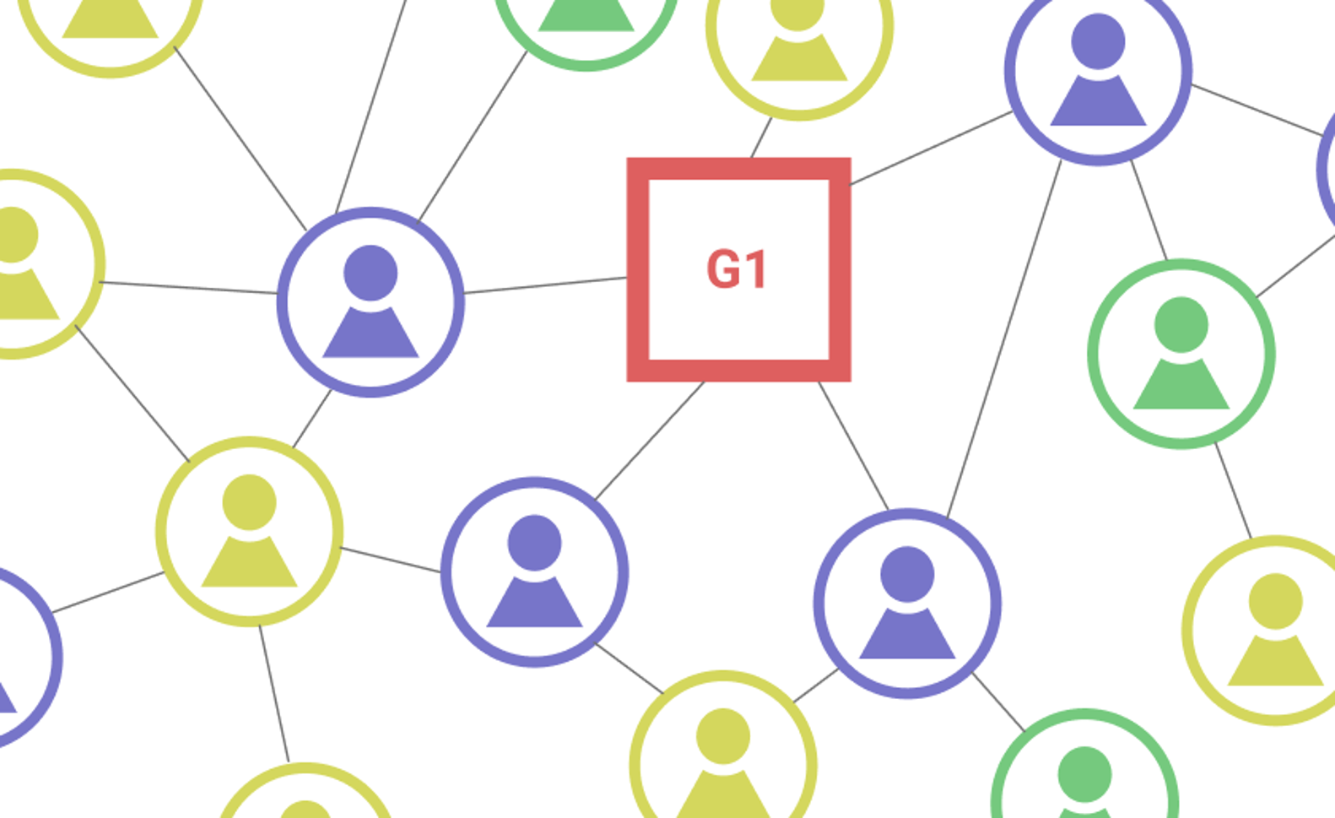
Ridesharing in Social Network
Peter S 11710116
Mike 11710403
Andrea 11712606
Instructors
Georgios Theodoropoulos
Masatoshi Hanai
Innovation project: Ridesharing in Social Network – stage 2
2020-04-30

Slide 2
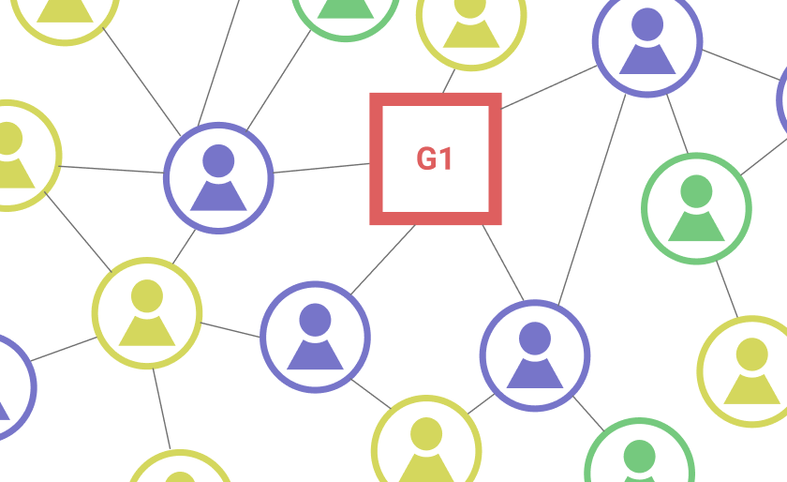
Objective
Given a road network, a social network, a set of vehicles and a set of passengers with ridesharing requests, we try to find an arrangement schedule to maximize the overall utility of passengers as well as the request handling rate, which is the number of successful handle requests.

Slide 3
Problem Instance
Road Network
G = <V, E, w>
Social Network
Direct Friend List
Group/Organization List (Indirect)
Passenger/Request < s_{i}, e_{i}, t_{c} , t_{s}, t_{e} >
[s_{i}, e_{i}]: Source & Destination location
t_{c}: Request creation time
[t_{s}, t_{e}]: Time window (latest pick-up time & latest drop-off time)
Driver/Vehicle
Capacity
Scheduling Sequence S = {x₁, x₂, ..., x_{n}}, where xi represents a location

Slide 4
Re-discussion: Social Network as a Constraint
Measurement of passengers’ utility values
Passengers will have better ride experiences with the friends they know, or with their workmates in certain organizations
The constraint helps with the goal of reaching a high overall utility
Possible Issue
Adding a constraint might lead to a decrease of the request handling rate: solve by relaxing closeness of passengers
Using social network data might encounter privacy issue: solve by fetching the user’s data only to compute closeness, instead of using the whole network (More novel ideas from the instructor, such as block chain)

Slide 5

Re-discussion: Existing Approaches
[2015 AAAI]^{[14]}: Consider only direct friendship
Shortcoming: “filter too much”, the constraint is too tight
According to the KDD paper^{[21]}, “only 9% of users share their check-in locations with their friends.”
We should consider relaxing the constraint such that indirect relationships are allowed
[Top-K]^{[21]}: Compute the number of hops in the social network
Shortcoming: the entire social network is required, such large data is not easy to obtain, and the users can access other users’ data indirectly, which is not safe
We should consider using only the required users’ data and restrict access to other users’ data
[2017 SIGMOD] ^{[18]}: Utility-Aware -> Jaccard Similarity
Shortcoming: fail to consider direct friendship case
We can extend Jaccard Similarity function

Slide 6
Modifying Simulation
Three types of instance: customer, vehicle, and social network.
One road network.
A series of requests from customer.
A schedule (route) for each vehicle.

Slide 7
Customer
Customer id: the identity number of customer.
Origin id: id of the origin node.
Destination id: id of the destination node.
Early time: early bound for time window.
Late time: late bound for time window.
Load: capacity cost of customer.
Status: waiting, on_board, arrived, cancelled.
Assign to: associated vehicle id.

Slide 8
Vehicle
Vehicle id: identity of vehicle.
Origin id / Destination id / Early time / Late time.
Load: matched customers but not picked yet.
Distance: distance to next node.
Route: array of every nodes that vehicle passes by.
Schedule: array of destination nodes.
Route id: current node id of vehicle.
Vehicle status: waiting, in_route, arrived.

Slide 9
Social Network
Network id: identity of social network.
Customer id: identity of customer.

Slide 10
Other parameters
Road network:
Node1: id of from node.
Node2: id of to node.
Distance: distance between node1 and node2 (in meter).
Longitude: position.
Latitude: position.
Request:
Post time: order post time.
Waiting time: customer would wait until cancel the order.
Late tolerance: customer would accept arrives later than late time.

Slide 11
Experiment Set
Use Cargo [VLDB 2019] as base simulator.
Modified to fit social network (under MIT license).
About 400 line of codes added.
Social network constraint: only customers in same social network can in same vehicle.

Slide 12
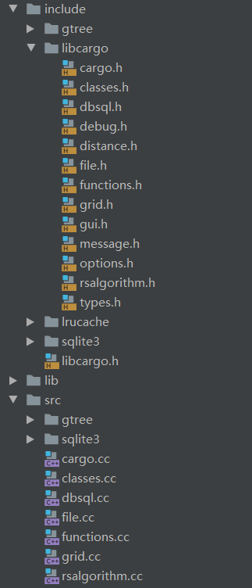
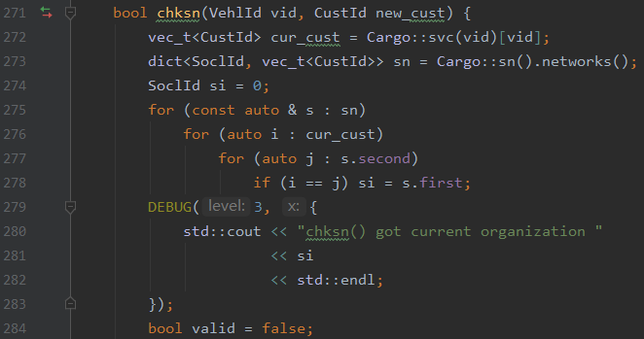
Experiment Process
Build Gtree from road network.
Read dataset into memory.
Based on time, count to process operation.
Generate report of result.

Slide 13
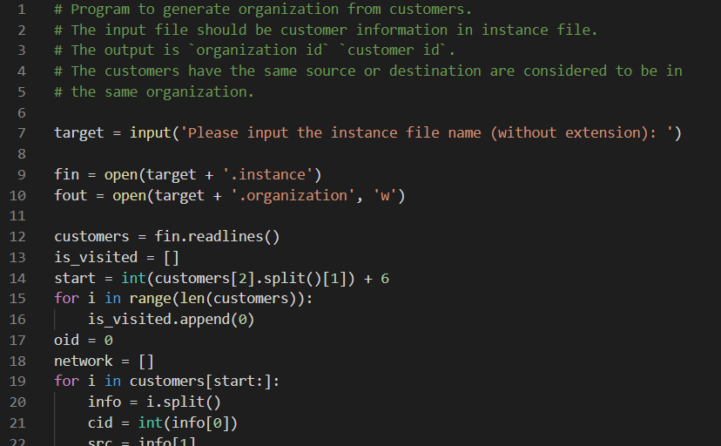
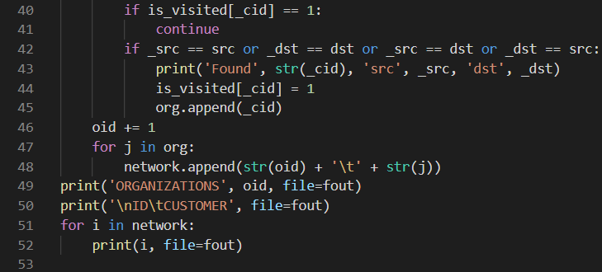
Generate Social Network
Assumption: customers with same origin node or destination node would be in same social network.
For example: colleagues in same building, classmates in same campus, neighbors in same department…

Slide 14
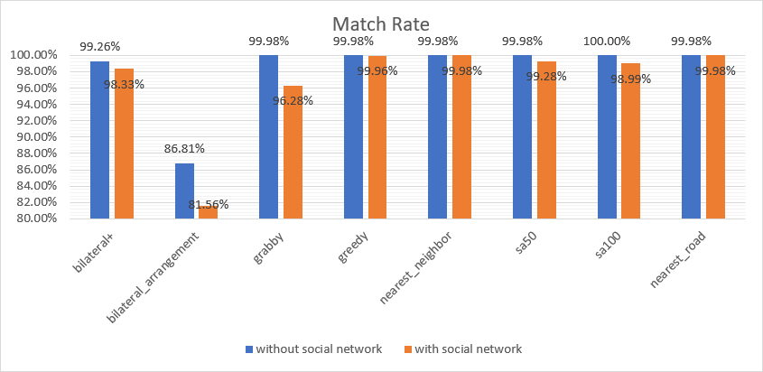
Experiment Result
Under Manhattan’s taxi data, different algorithms performs.

Slide 15
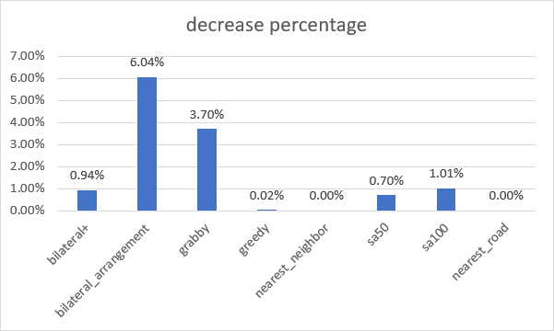
Comparison of Social Network
The match rate would lower after constrained by social network.

Slide 16
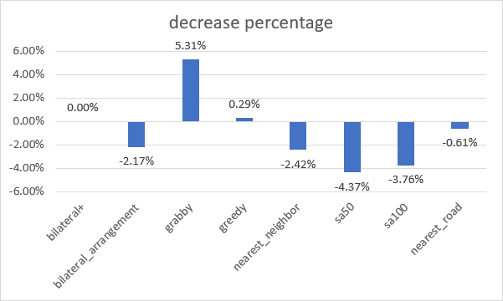
Comparison of Social Network
If social network are large and with small amount, the constraint may optimize the performance.

Slide 17
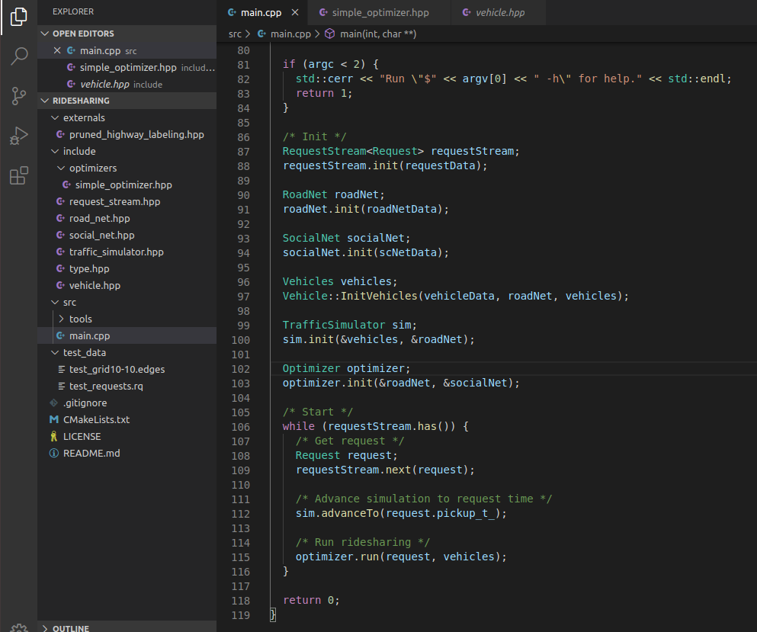
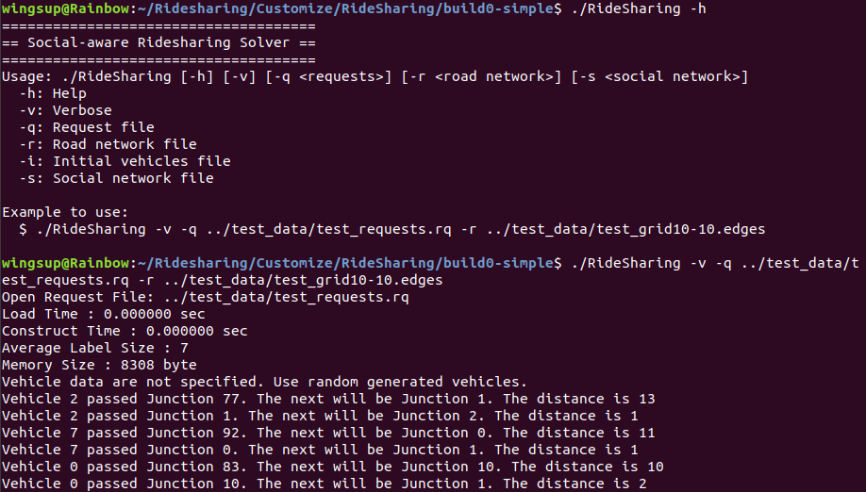
A New Framework - More Efficient Simulation
Coded in C++

Slide 18
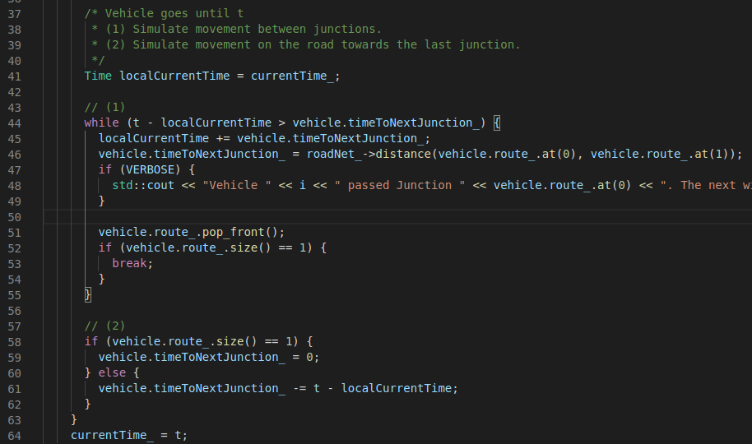
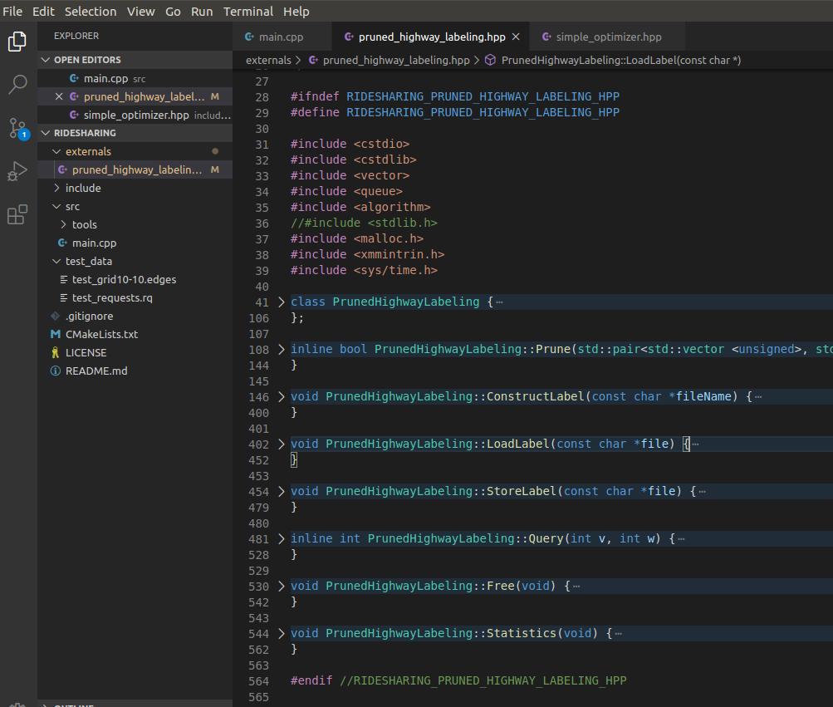
A New Framework - More Efficient Simulation
Event-driven simulation rather than time-driven simulation
Compute junction-to-junction
Compute junction to point on the road
Use fast indexing method for shortest path on road network - PHL (Pruned Highway Labelling) from [ICDE 2019]^{[22]}

Slide 19
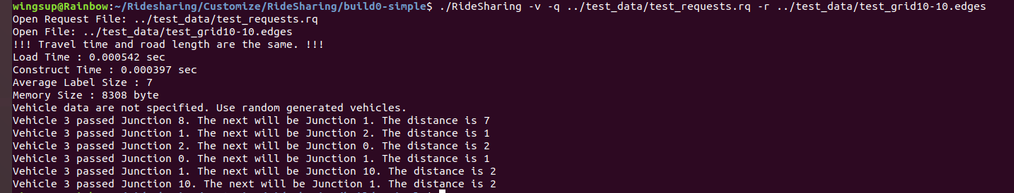
What We’ve Done in the 2nd Stage
Mike
Analyze AAAI paper
Baseline - Cost-first Greedy
Problem Definition
Andrea
Analyze Top-K paper
Digital Twin System Adaptation
Experiments & Analysis
Peter S
Analyze Utility-aware paper
Summarize Social Network Issues & compare with existing work
New Framework Analysis

Slide 20
Timeline
For the next Stage:
Adapt Digital Twin to our new framework
Design our own algorithm to solve the problem more efficiently, and compare the results with existing algorithms
Think about the privacy issue once using social network
...

Slide 21
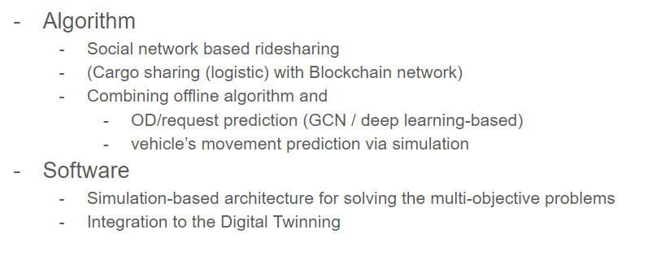
Extra Ideas from ASIA LAB
Thanks for Listening.

